Slide 1



Your Guide to Crafting the Perfect Pitch
Heather Lawver
FOUNDER & CEO • HEATHER@CEEMO.AI

Slide 2







to totally free pitch
design, writing & delivery resources
Free Pitch Resource Guide
WWW.CEEMO.AI/RESOURCES

Slide 3
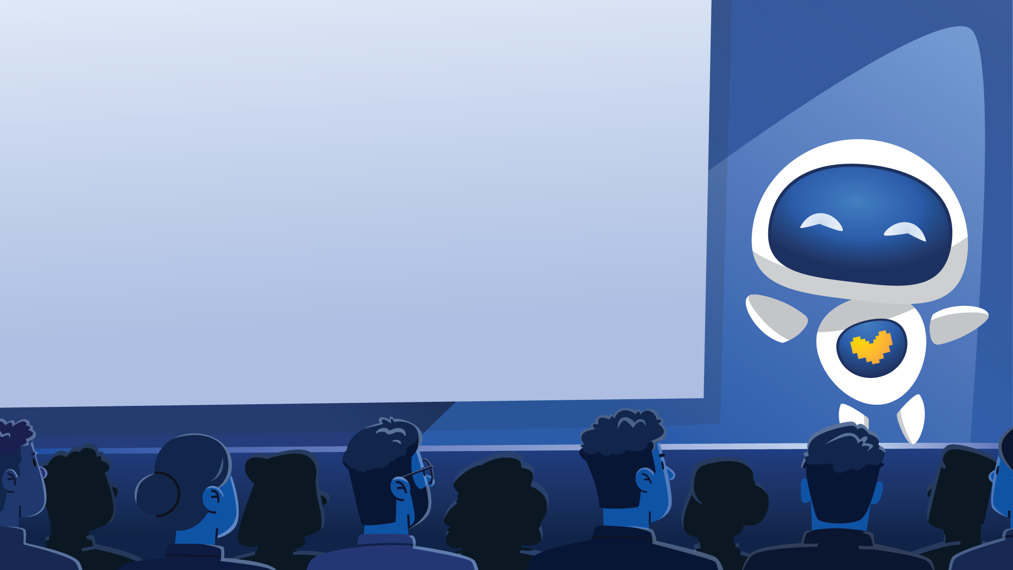

Believe me, I know pitching can feel like an overwhelming juggling act!
You're not just creating slides; you're simultaneously wrangling design, branding, writing, strategy, financials, and public speaking. All in a captivating story told in mere minutes!
I'm Ceemo & my mission is to lighten that load, so you can focus on what you do best.
I'll share three Perfect Pitch Frameworks to help you organize your thoughts & streamline your storytelling into an investor-ready pitch.
Want a little extra help? Check out our software at www.ceemo.ai, which can further lighten your load across strategy, storytelling & beautiful design.
Let's dive in, because I know you can pitch like a pro!

Slide 4
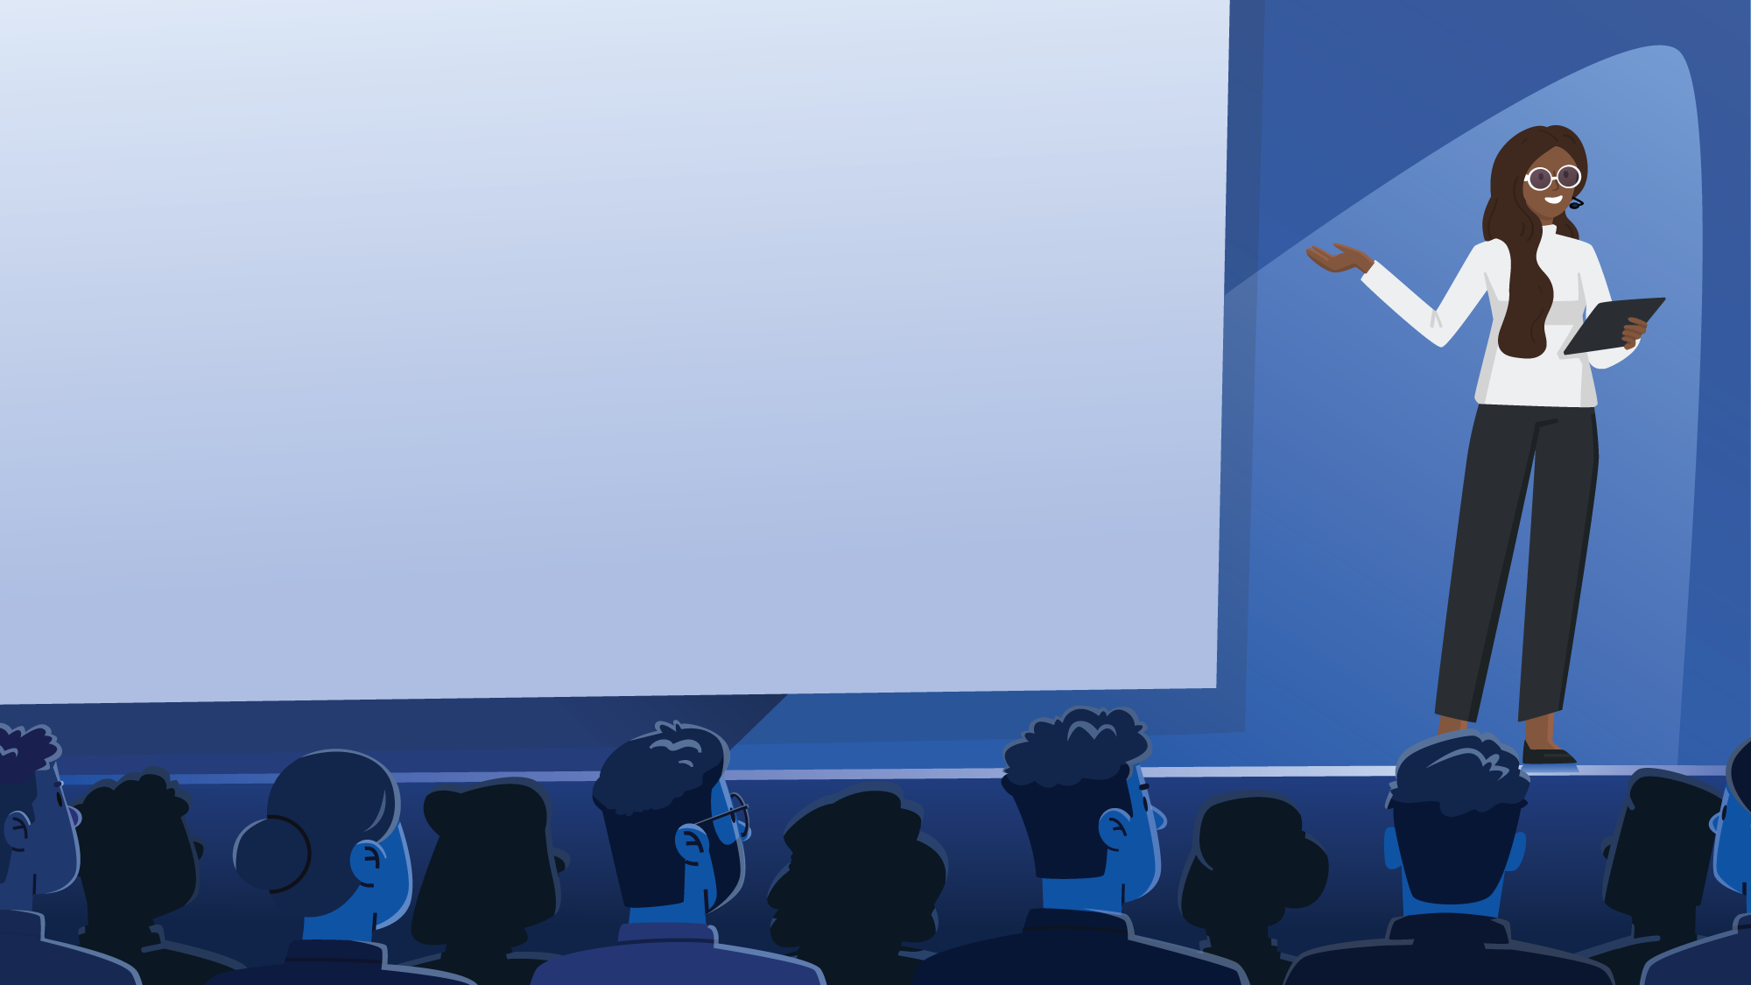
HOW TO MASTER CEEMO’S
Perfect 2 Minute Pitch
INTRO • 20 SECONDS
Who you are, what you do & why you’re special.
PRODUCT • 40 SECONDS
A relatable problem & a quick journey through your solution.
TRACTION & ROADMAP • 40 SECONDS
Your last big achievement & your next big goal.
A VISIONARY ASK • 20 SECONDS
Your ask to build a better, brighter future.

Slide 5

Homework: Craft Your 2 Minute Pitch
INTRO • 20 SECONDS
PRODUCT • 40 SECONDS
Who you are, what you do & why you’re special.
A relatable problem & quick journey thru your solution.
Make a copy, double click, and insert your script here!
Need help? Sign up for Ceemo & our specially trained chatbot can help you craft a compelling script!
Insert your script here!
TRACTION & ROADMAP • 40 SECONDS
A VISIONARY ASK • 20 SECONDS
Your last big achievement & next big goal.
Your ask to build a better, brighter future.
Insert your script here!
Insert your script here!

Slide 6
Extra Credit: Plan Key Emotions for Each
INTRO • 20 SECONDS
PRODUCT • 40 SECONDS
Who you are, what you do & why you’re special.
A relatable problem & quick journey thru your solution.
Insert your script here!
Insert your script here!
KEY EMOTION: Type what you want the audience to feel.
KEY EMOTION:
TRACTION & ROADMAP • 40 SECONDS
A VISIONARY ASK • 20 SECONDS
Your last big achievement & next big goal.
Your ask to build a better, brighter future.
Insert your script here!
Insert your script here!
KEY EMOTION:
KEY EMOTION:

Slide 7
Scroll to page 23 to
see how we’d visualize
this story!
Homework: Example 2 Minute Pitch
INTRO • 20 SECONDS
PRODUCT • 40 SECONDS
Who you are, what you do & why you’re special.
A relatable problem & quick journey thru your solution.
Hi, I'm Tyberius Lawver, Founder & CEO of Doggie Tuxedos. As a dog mom who believes our furry friends deserve to be part of life's most magical moments, I've created more than just clothing - I'm creating experiences that celebrate the bond between dogs and their families.
Dogs get left behind during life's memorable moments, because pet clothing is poorly designed, uncomfortable, and looks cheap. Doggie Tuxedos creates custom-fitted, tailored formal wear for dogs, ensuring they're present & CELEBRATED at family events. We design for unique breeds, using high-quality fabrics that make dogs look like they truly belong.
KEY EMOTION: Cute Aggression, ‘Aww, so cute!’
KEY EMOTION: Nostalgic, Warm Fuzzies
TRACTION & ROADMAP • 40 SECONDS
A VISIONARY ASK • 20 SECONDS
Your last big achievement & next big goal.
Your ask to build a better, brighter future.
In year 1, we dressed 200 dogs & developed a ready-to-wear collection that fits all dog breeds thanks to our scalable algorithmic patterns. We’ve dressed winners of dog shows, Crufts & Westminster. We're generating $6k/mo revenue, with a clear path to scale. By Q4 2025, we project $45k/mo recurring revenue through our innovative ready-to-wear line.
We're looking to raise $500,000 to fund our first ready-to-wear collection and fulfill our first purchase orders. Join us in reimagining how families celebrate - where every dog gets to be more than a spectator, but a cherished participant in life's most meaningful moments. With your support, we'll ensure no furry family member gets left behind again.
KEY EMOTION: Aww at accomplishments, trust in goals
KEY EMOTION: ‘I want to take my dog to my wedding!’

Slide 8
Extra Helpful
tips & tricks

Slide 9
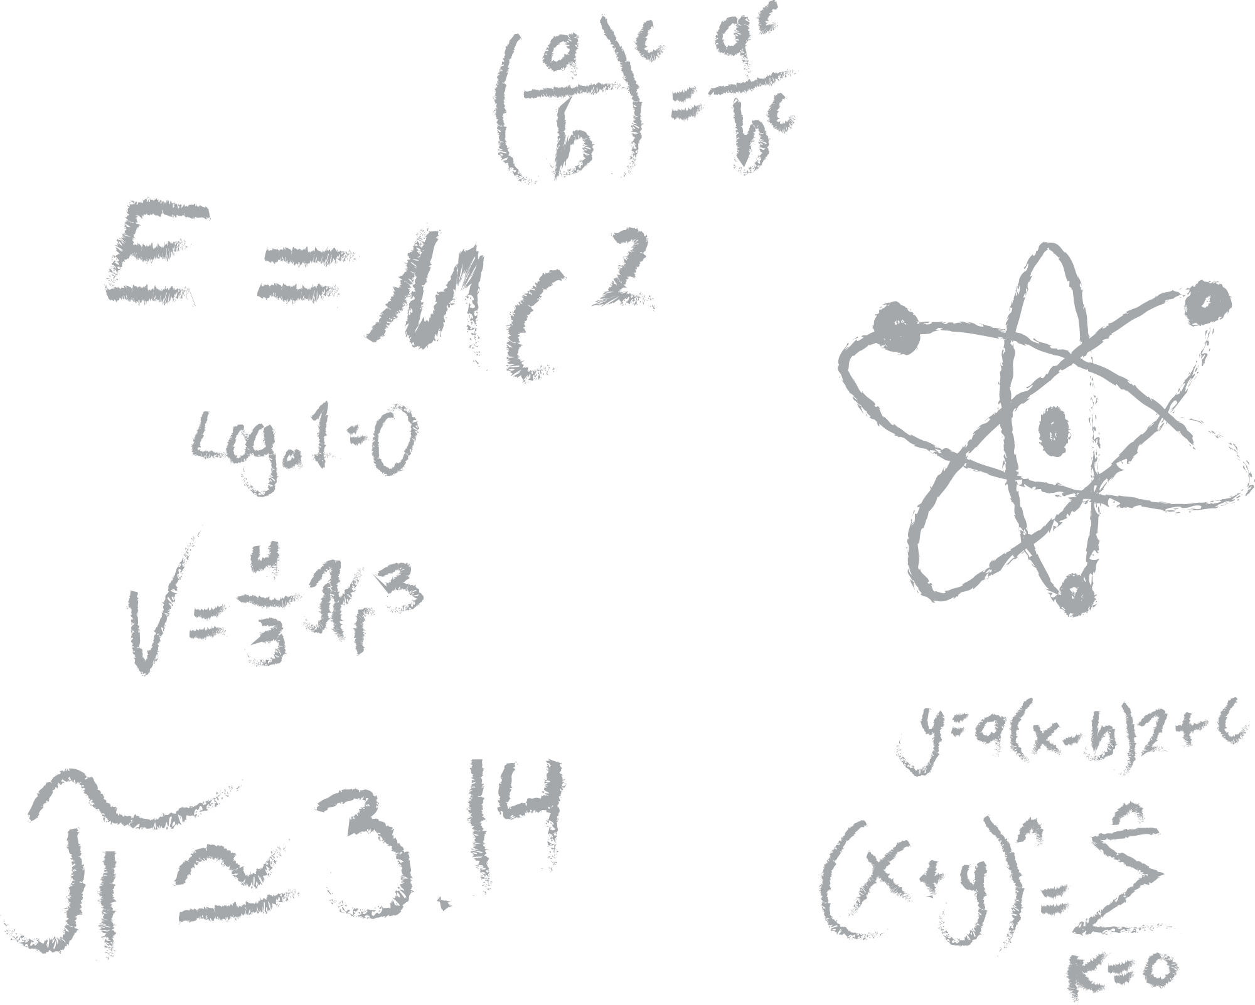





Ceemo’s Perfect Pitch Pro-Tips
One Slide, One Big Idea
Give each slide one key message you want your audience to understand & remember. Ensure every word & design element reinforces that one key point.
One Slide, One Guiding Feeling
Once you’ve decided on your message, pick a feeling or ‘Ah HA!’ moment that will make your big idea impactful. Plan your script & performance accordingly!
Rule the Stage with The Rule of 3’s
It’s proven that our working memories can retain 3 things at a time. Add a 4th & we’ll start to forget! Stick to 3 things per slide, or group items into 3 categories.
Step By Step With Simple Transitions
It’s easy for audiences to read ahead or get overwhelmed. If you’re okay with it, keep us on track with simple transitions; build each item in as you talk about it.
Big Advice For Big Brains

Slide 10





Ceemo’s Perfect Presenting Pro-Tips
Remember To Breathe
Adrenaline will start pumping before a pitch! Try Box Breathing: inhale for 3 seconds, hold for 3, exhale for 3, hold for 3, repeat. Breathe in deep, it works!
The Audience Is A Mirror
Whatever emotions you present will be reflected back by the audience. If you’re nervous, they’ll be nervous. Pitch like they’re rooting for you. (Because they are!)
Always Have An Ask & Call to Action
By all means ask for money! But not everyone can invest, yet anyone in that audience could open the next door of opportunity. Give us 2 ways to help you!
You Are Not Begging for Money
Investment is a huge power imbalance; it’s easy to feel small. Remember, you’re extending an exciting opportunity they’d be lucky to join. Pitch with that power!
Good Tips For Good Speakers

Slide 11
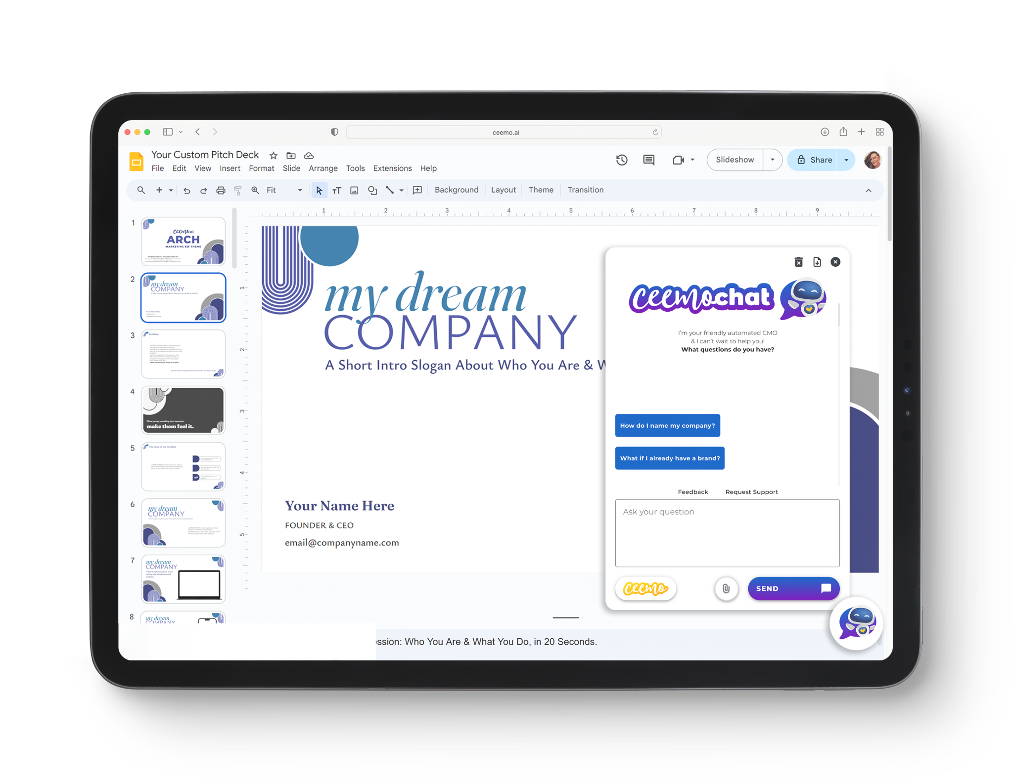

Want a Little More Help? We Got You!
Smarter Brands.
Ceemo’s Brand Quiz uses Crunchbase insights to create customer-focused brands.
Compelling Decks.
Your Asset Library instantly generates custom marketing & pitch assets in your fonts & colors.
Instant Support.
Ceemo’s AI Pitch Coach helps craft compelling narratives & strategies to serve, grow & fundraise.
Notes:
The Problem Slide - Explain the exact problem your customers experience, the precise problem you solve. Make it emotional, make it human!
Ceemo Notes: Follow the instructions in the text to add your own photos to visualize your unique problem. We highly recommend finding free stock imagery from our friends at Unsplash.com! To add your imagery, go to “Insert > Image >” then choose whichever option suits you. Size it to where you need it. Or, for extra impactful & visually appealing slides, you can size it to fill the entire screen! Then you can set it to the appear behind your design motifs! To do that, resize the image to fill the screen, while making sure not to stretch it beyond its original aspect ratio. Then, select the image and go to “Arrange > Order > Send to Back”. Then you’ll see how your design motifs pop on top, to frame your image and make it blend it beautifully with your branding!
Don’t feel like you have to contain the entire narrative of your problem to just two slides! Get creative, don’t be afraid to use big bold imagery. The most important thing is that you engage your audience’s “Emotional Brain”; tug at those heartstrings, help them feel what it’s like to experience this exact pain point. Help them feel the urgency of searching for that solution, that urgency to find you!
Level Up Your Design: For Problem slides, we highly recommend using black & white imagery here. Black & white amps up the emotion and triggers the audience’s brains into what’s called Binary Thinking. It helps them juxtapose the negative emotions of the Problem, against the positive emotions of your bright & colorful solution! We call it the “Wizard of Oz Effect”, where you step out of drab and boring Kansas (the problem) into the bold technical of Oz (your solution!) Claim your own Oz moment by sticking with black, white, and shades of grey while discussing the Problem.
If you want to use all black & white, scroll down to Extra Appendix Slides! You’ll find copies of these exact slides, but in stark blacks & whites.

Slide 12
Deeper Dive
frameworks

Slide 13


The Ceemo 5-7 Minute Pitch Framework
Need to expand your pitch? Use this template and add 1-to-3 bullet points to each segment, as needed, to keep building your pitch. Remember, this isn’t a full crash course on your business! This is a movie trailer, enticing them to learn more.
1 • INTRO
5 • PROGRESS & ROADMAP
Who are you, your title, your company, and a one sentence intro of what your company does. For instance, “I’m Heather Lawver, Founder & CEO of Ceemo. We generate instantly smarter brands, marketing & pitch decks for today’s top entrepreneurs.”
Show you have a habit of making goals & achieving them. On one slide looking back, show us 2 strategic steps taken & 3 goals accomplished. Looking forward, what 2 strategic steps & 2 interim goals will lead to a big milestone in 12-18 months?
2 • A COMPELLING PROBLEM
6 • WHY NOW & WHY YOU
What problem(s) do you solve & for whom? How big is that problem? How much does it cost/how many does it affect? Don’t just give us facts/figures. Make the problem feel human!
Why is now the time to take action & why should they join you? Who’s on your team, have they been trained/vetted, and what makes you uniquely qualified to make this a success?
3 • YOUR UNIQUE SOLUTION
7 • YOUR ASK FOR YOUR FUTURE
What is your solution & how does it work? Quickly walk us thru the user journey so we can imagine being your customer. How much better will the world be thanks to your company?
We should know exactly what you’re building, why, how you’ll make it happen, and who’s on the team. Now we need to know what you need from the audience to make it possible. Ask!
4 • MARKET & FINANCIALS
8 • A GRATEFUL CRESCENDO
What does it cost to make & what’s the price? How will you sell it and reach scalability? Show us your 3-5 year projections. How big is the market & what makes you unique within it?
Create a “giver’s high”. Quickly remind us of the problem’s pain, help us feel the excitement of being the one to solve it. Thank the audience & invite them to join you building a better world.

Slide 14
The Ceemo 7-10 Minute Pitch Framework
Add 1-to-3 bullet points to each segment, as needed, to refine just the main points you need to get across in a pitch deck. Follow this template & you should have all the information needed for an investor presentation.
1 • INTRO
7 • COMPETITORS
Introduce your name, title, company name, and a one sentence summary of what your company does & for whom.
What gaps exist in the market? How will you fill that gap to gain an edge? When 9/10 startups fail, why will YOU succeed?
2 • PROBLEM
8 • PROGRESS & ROADMAP
What problem(s) do you solve & for whom? How big is that problem? How much does it cost/how many does it affect?
What 2 steps did you take to achieve 3 recent milestones? What steps will you take to accomplish a big milestone in 12-18mos?
3 • YOUR SOLUTION
9 • SIMPLE PROJECTIONS
What is your product & how does it work? Quickly walk us thru the user journey so we can imagine being your customer.
With milestone achieved, what will you earn? And in 3-5 years? Show dollar figures & how many sales/customers that takes.
4 • BUSINESS MODEL
10 • TEAM
What does it cost to make & what’s the price? How will you sell it and reach scalability? At what point will you be profitable?
Show team’s photo, name, title & 2-3 logos of schools/employers. What’s unique about the team that will ensure success?
5 • GO-TO-MARKET/SCALE STRATEGY
11 • YOUR ASK
Who is your ideal customer? How will you get their attention? How will you reach scalability? How will you win?
Always have an ask, but it doesn’t have to be money! What do you need from the audience to reach that key milestone?
6 • MARKET OPPORTUNITY
12 • GRATEFUL CRESCENDO
How big is the market? How can you target & capture a key segment of that market? Any comparable companies?
Remind the audience how great the world will be with that problem solved. Thank them & have contact details on slide.

Slide 15
p.s. an extra special
sample pitch
Pitching a fictional company!
This sample has everything for a 5-7 minute pitch.
How would you shorten it to fit the 2 minute framework?
Check the Presenter Notes to see the accompanying script!

Slide 16



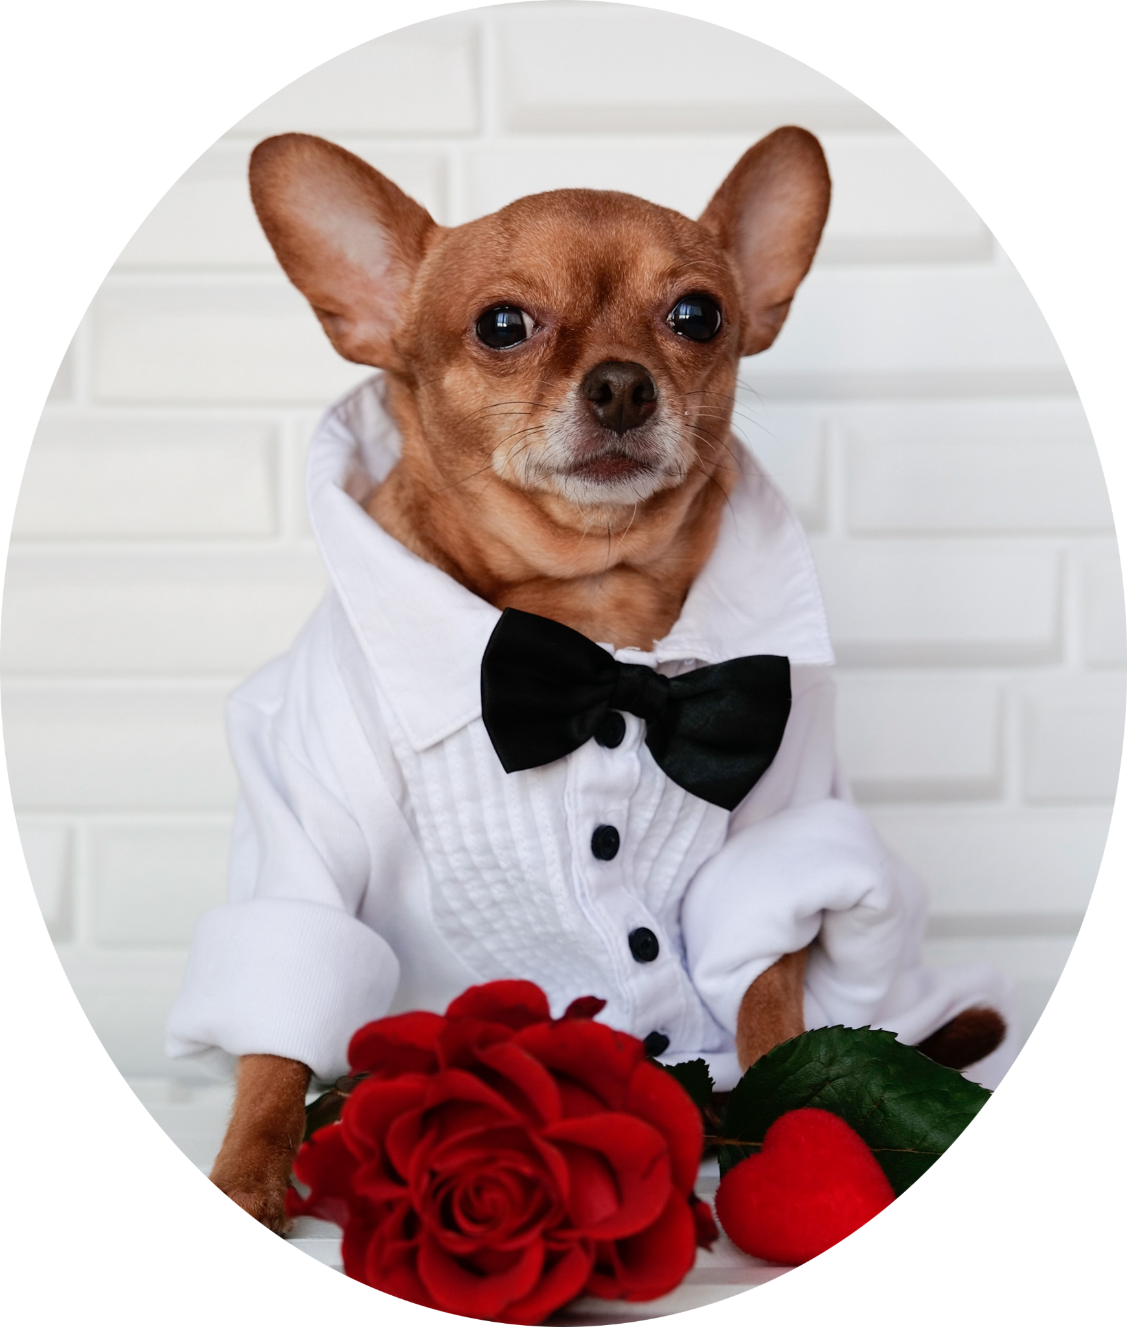
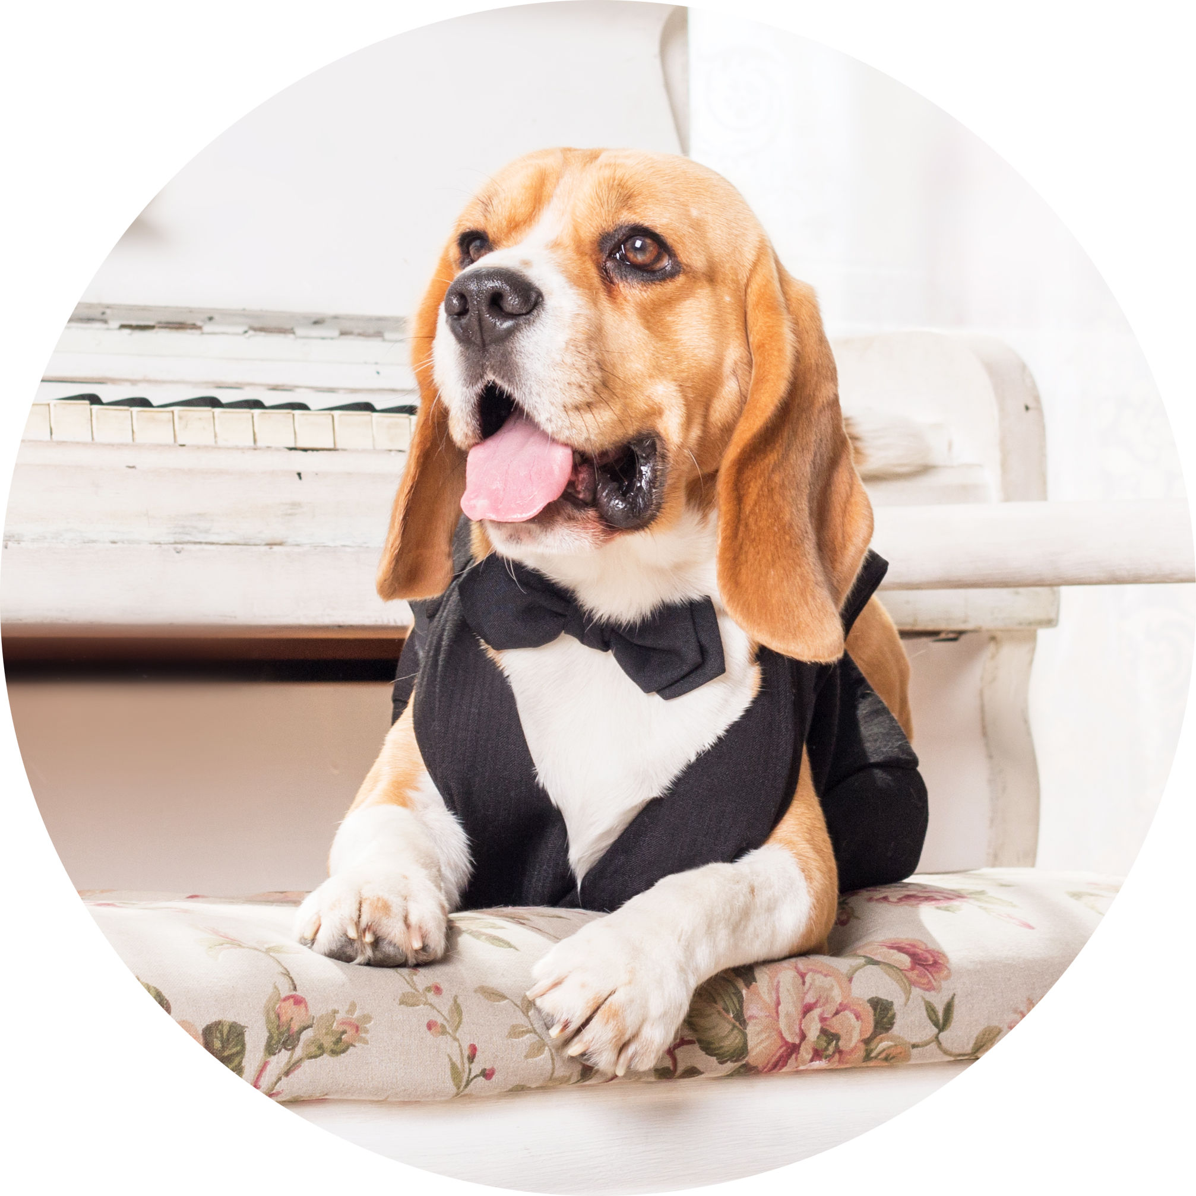
Custom Canine Couture at Scale
Because Every Dog is The Best Dog
Tyberius Lawver
FOUNDER & CEO ⬥ TY@DOGGIETUXEDOS.DOG
Notes:
Hi, I'm Tyberius Lawver, Founder & CEO of Doggie Tuxedos, where we create Custom Canine Couture at Scale, because every dog is the best dog.
(Note: This is an entirely fake company that does not exist, supposedly created by my own dog, Tyberius. Dogs cannot launch companies. Thus, this one is not true. Sorry.)

Slide 17
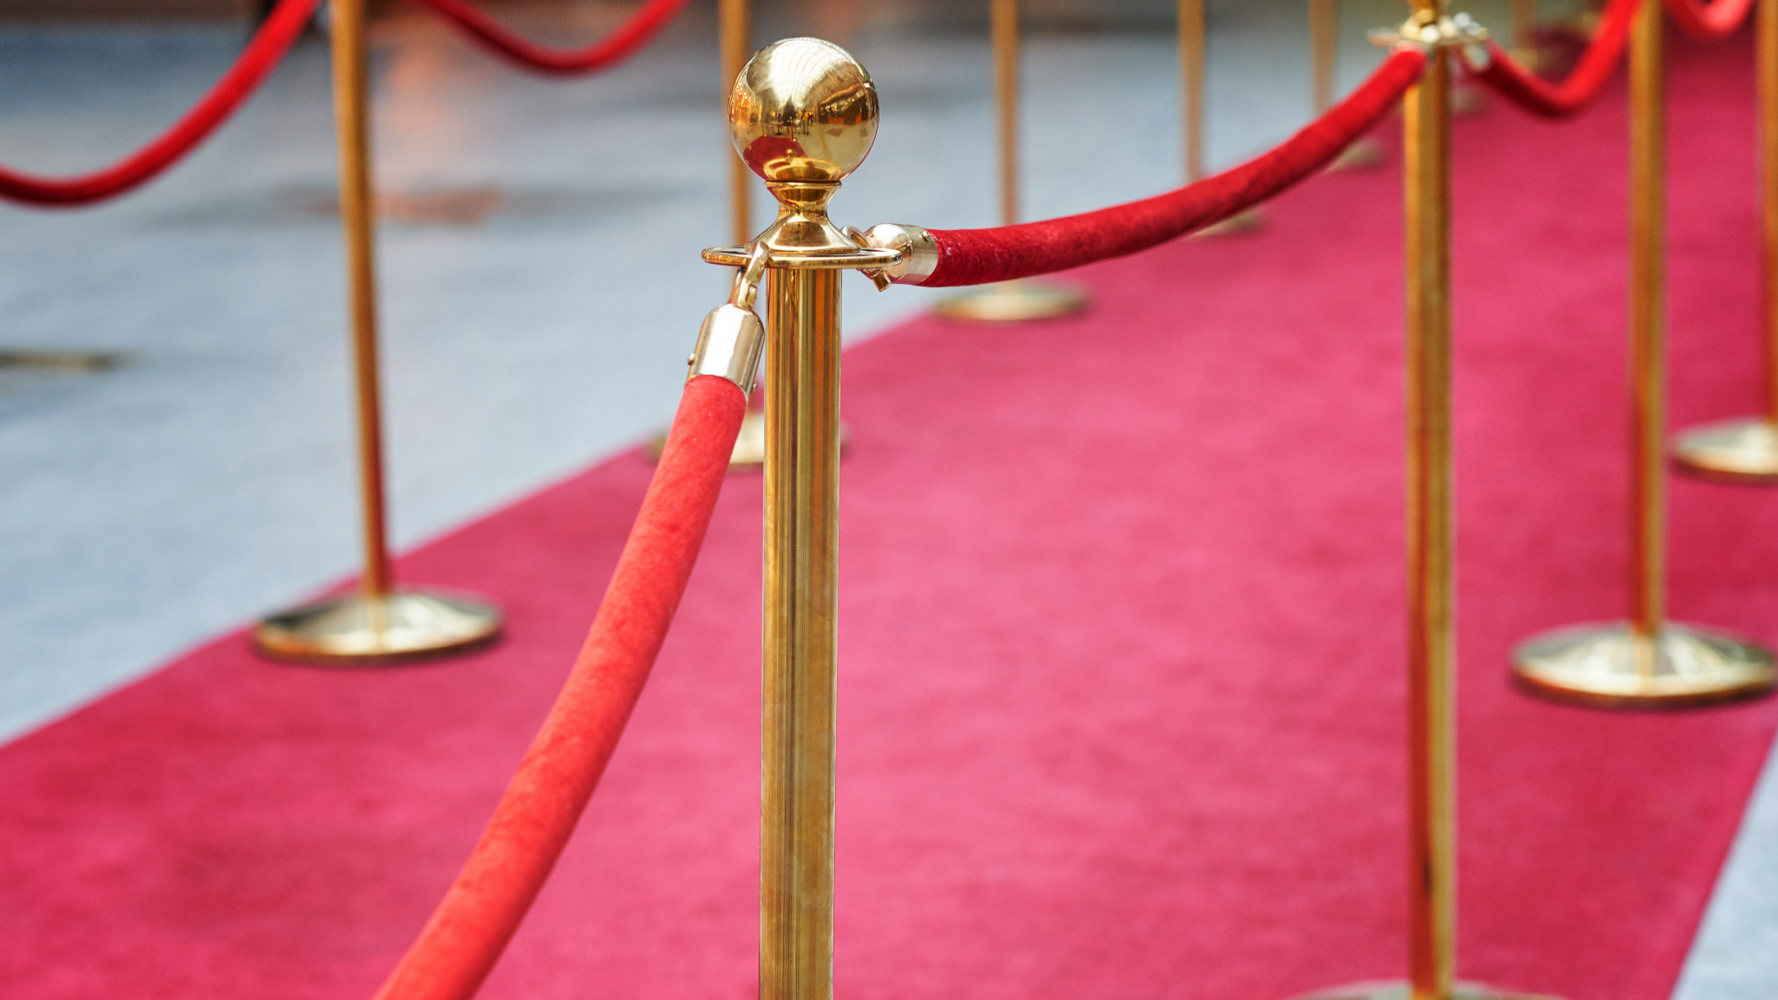
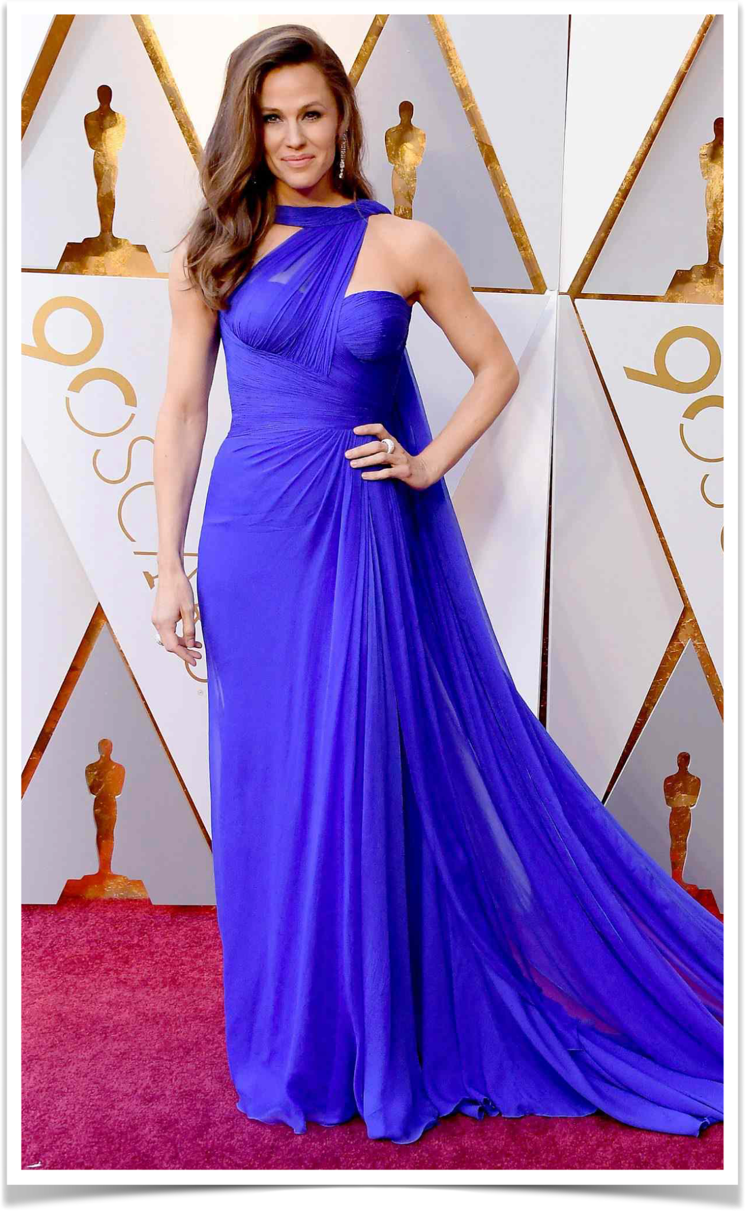
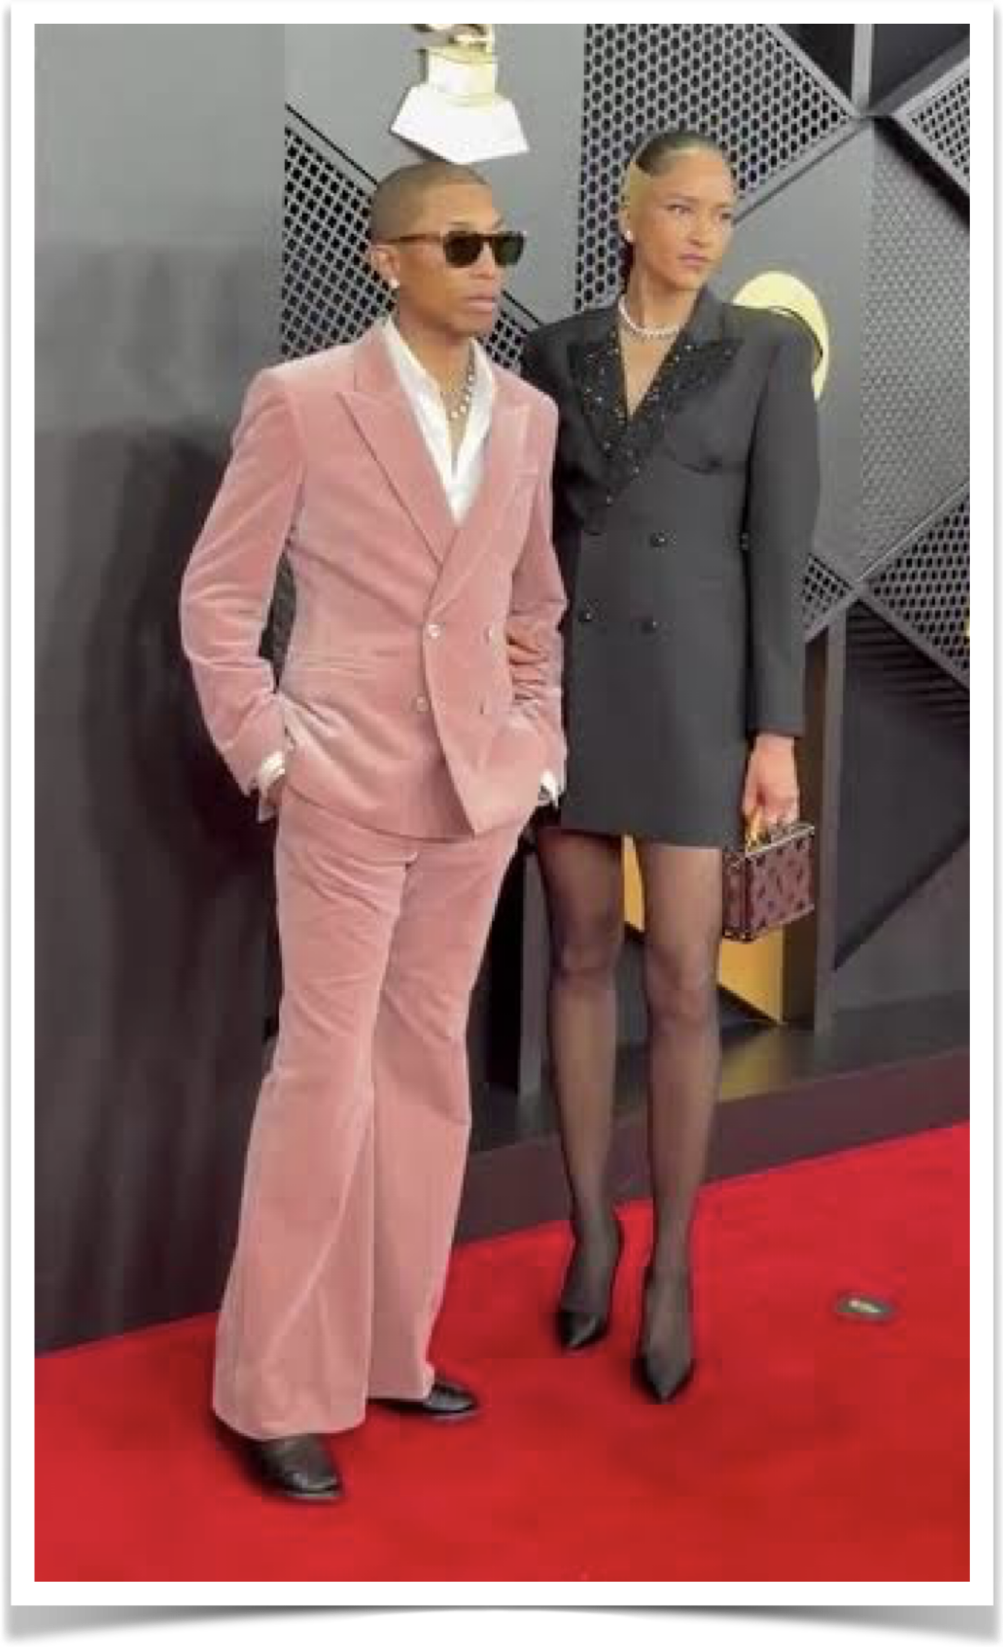
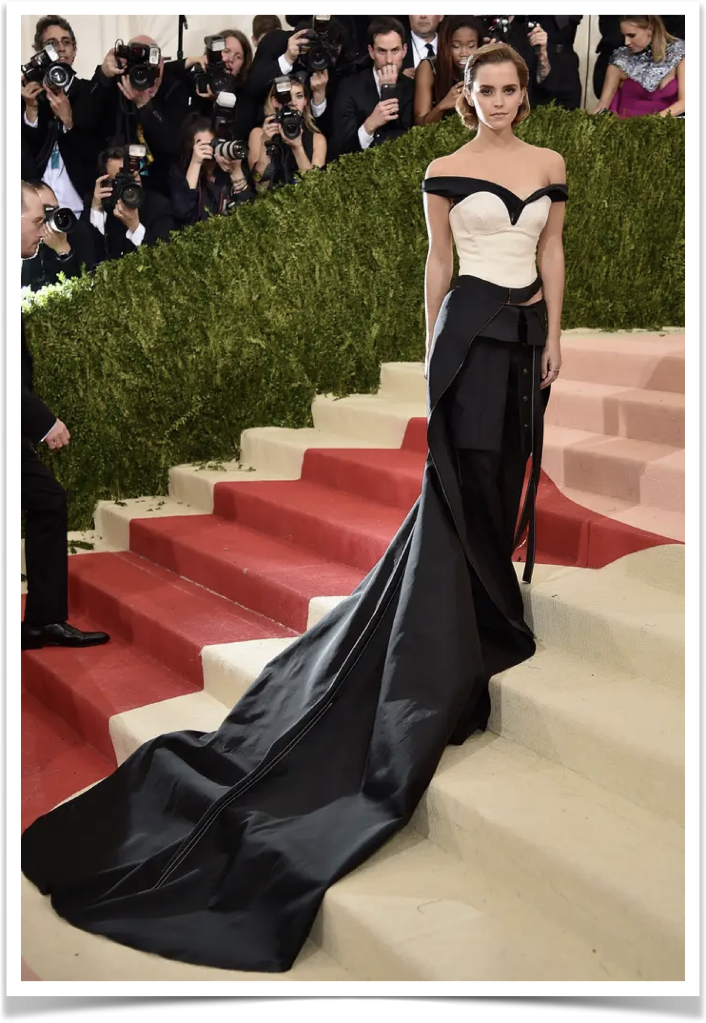
As a Fashion Designer…
I know how red carpet looks have the power to
BUILD BIG MEMORIES.
Notes:
As a fashion designer, I’ve created plenty of jaw dropping moments for big stars. I know how red carpet looks have the power to build BIG memories. But I’m also a dog mom, and I believe…
(Note: My dog did not create any of these red carpet looks. We have no official connection to Pharrell Williams, Emma Watson, or Jennifer Garner. Well. Except I did meet Emma Watson’s Dad once, I did once run a boycott against Warner Brothers over the Harry Potter movies (I won!), and I did create some of the first pitch decks and branding for Jennifer Garner’s ‘Once Upon a Farm’ company. Oh, and I work with a lot of folks who have won Pharrell Williams’ Black Ambition pitch competition! But beyond that, no connection, no official partnerships, and there was no intend to suggest any sort of endorsement from any of these lovely people. I just thought the existing ‘Kevin Bacon-esque’ connections were funny. And again, my dog is not a fashion designer. He’s only our Chief Floofy Officer. Anyway, carry on!)

Slide 18

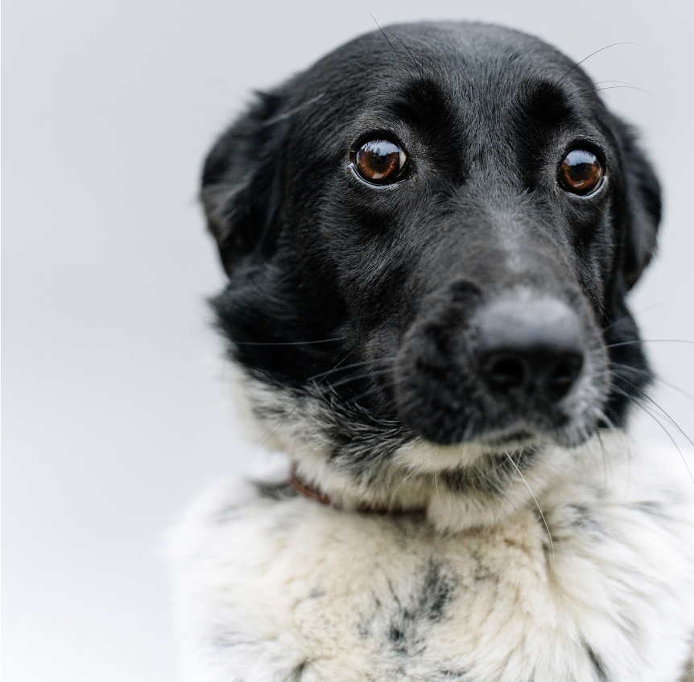
not every dog feels like
the goodest dog.
Notes:
…our furry friends deserve to be part of life's most magical moments. When they get left behind, not every dog feels like the goodest dog. Man’s best friend deserves better! Whether it’s red carpets, weddings, or once in a lifetime events…

Slide 19





Doggo Depression
75%
of dogs show signs of anxiety & depression
Families often don’t know how to train to events.
Easier but disappointing to leave furry family at home.
Notes:
Dogs get left behind because —> (trigger animation to bring in the first stat) pet “costumes” are cheap & poorly designed, NOT formalwear worthy of the occasion. Worse, —> (animate in the next stat) Families don’t know how to train their pups for events, so it’s —> (animate in last stat) easier but disappointing to leave just furry family at home. It’s time to change that.
(Note: That first stat is totally made up. Please do not make up statistics in your own pitch decks. Only cute fluffy dogs are allowed to make up pitch decks. But, notice how Tyberius isn’t overwhelming the audience by triggering all three info boxes at the beginning? He’s triggering them one at a time, just as his script calls for it. That way what the audience hears him say perfectly and effortlessly matches precisely what the audience is seeing. It keeps them engaged, keeps them from reading ahead, and keeps the slides visually interesting. Also, the text is VERY short, to keep the audience from splitting their attention. After all, when was the last time you listened to a novel and read a podcast at the same time? Keep the audience’s focus on you as the speaker and don’t ask them to read a great big paragraph all at once.)

Slide 20

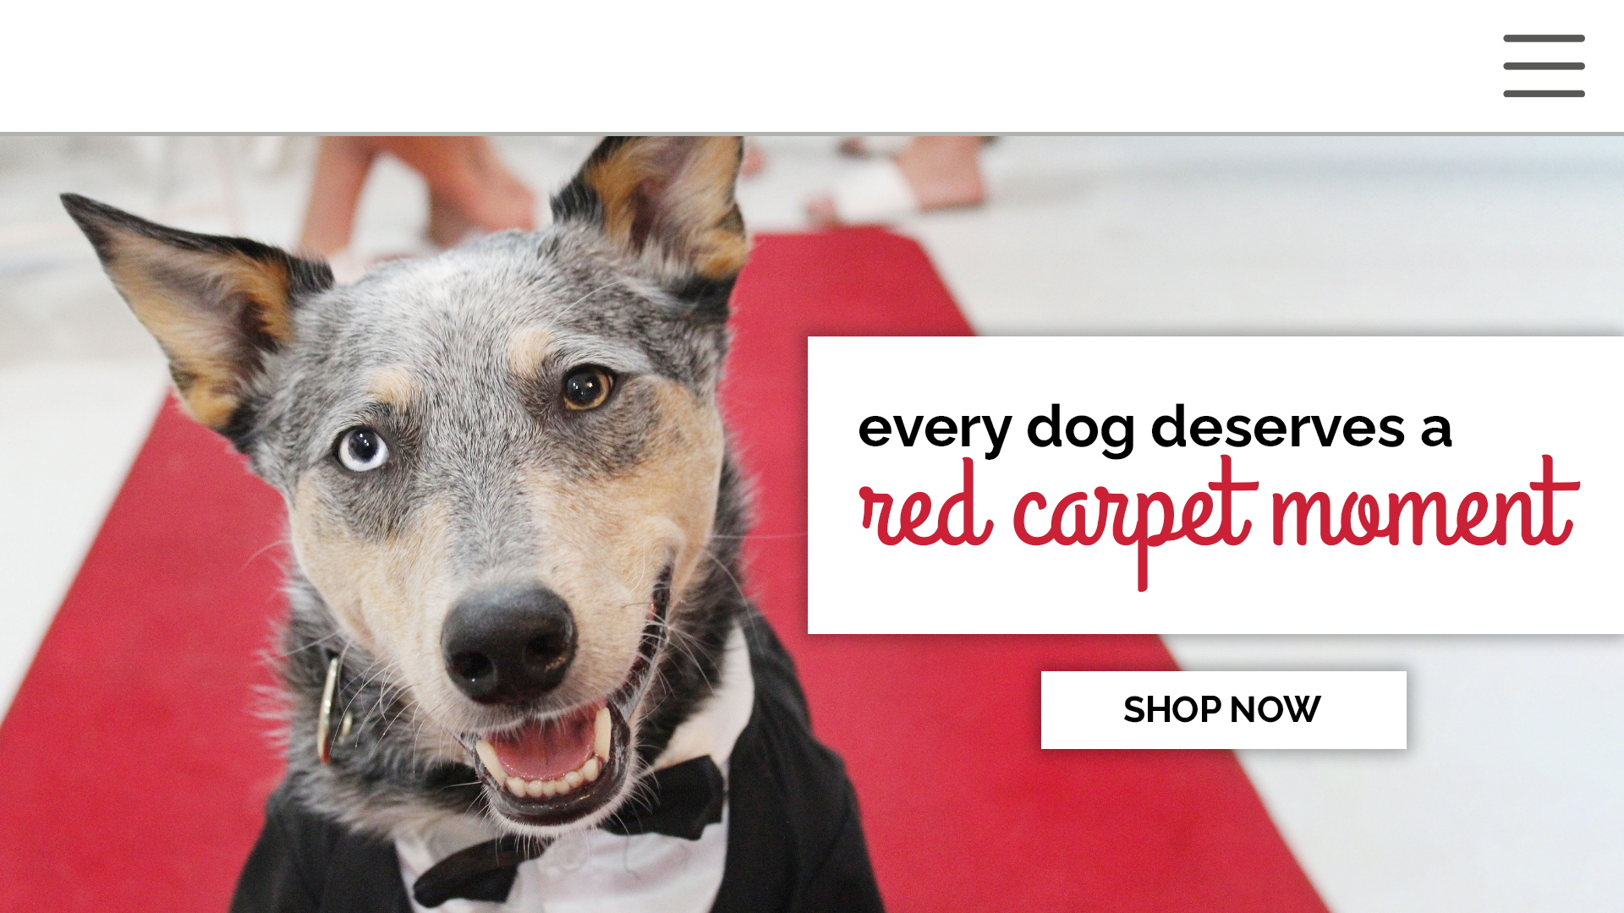
Tell your dog they
are the best dog and
say it with fashion!
Notes:
That’s precisely why we created Doggie Tuxedos, because → (trigger tagline animated fade in) every dog deserves a red carpet moment. → (trigger next subtle elegant fade in) Tell your dog they are the best dog and say it with FASHION!

Slide 21

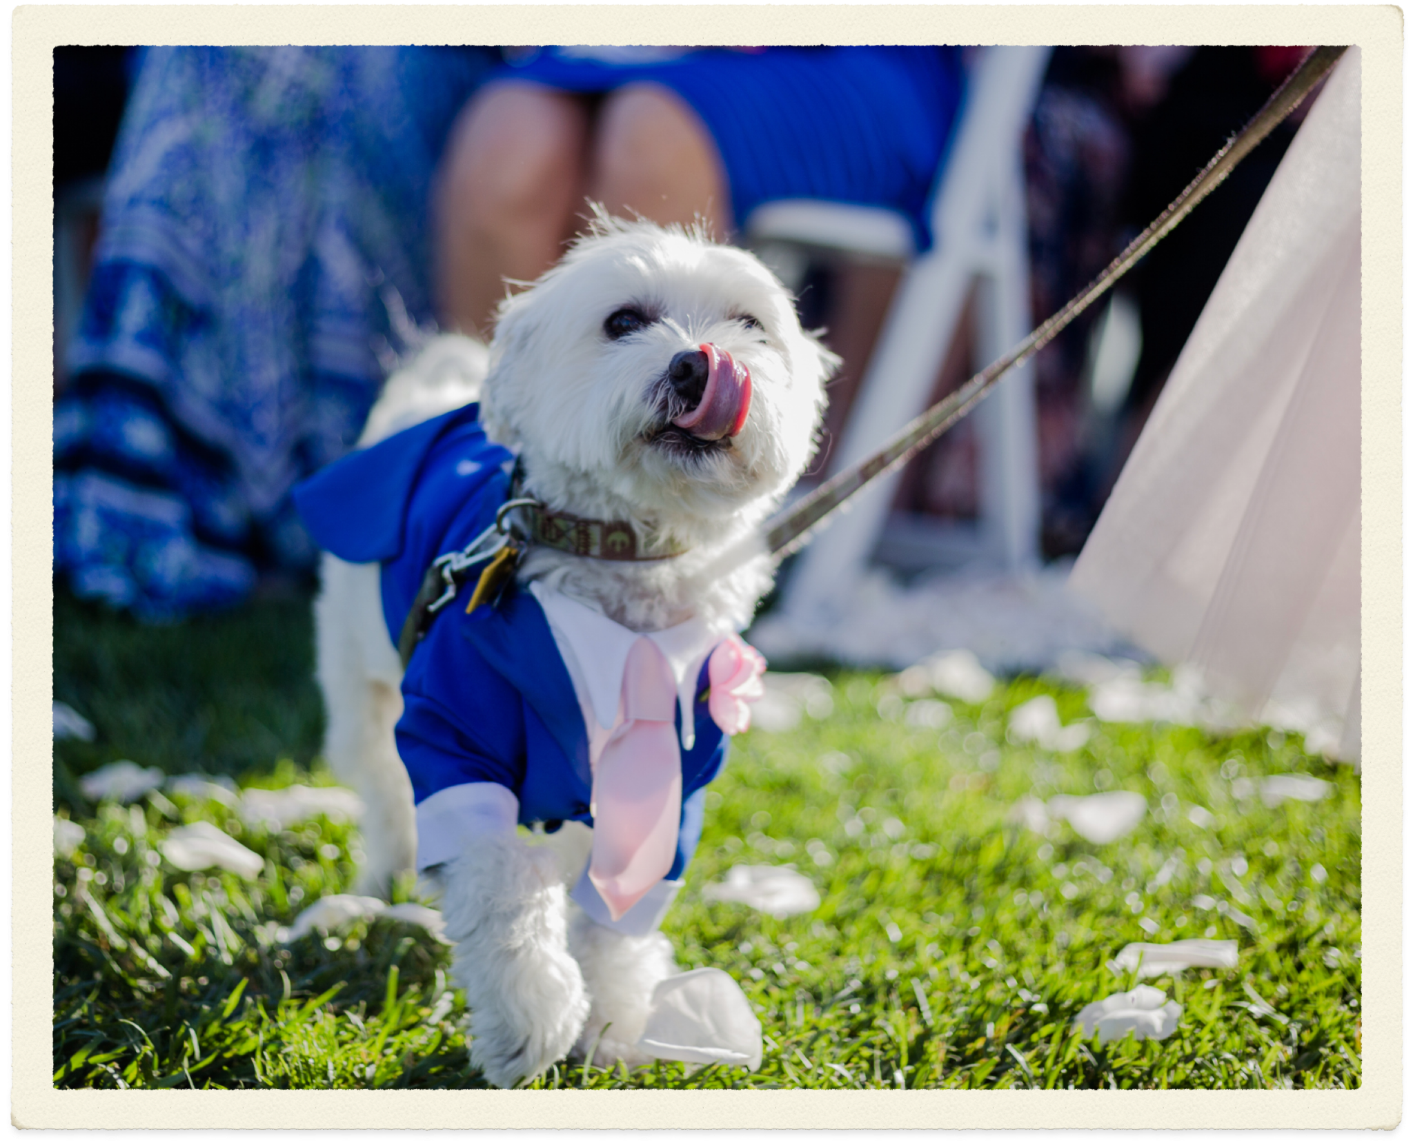

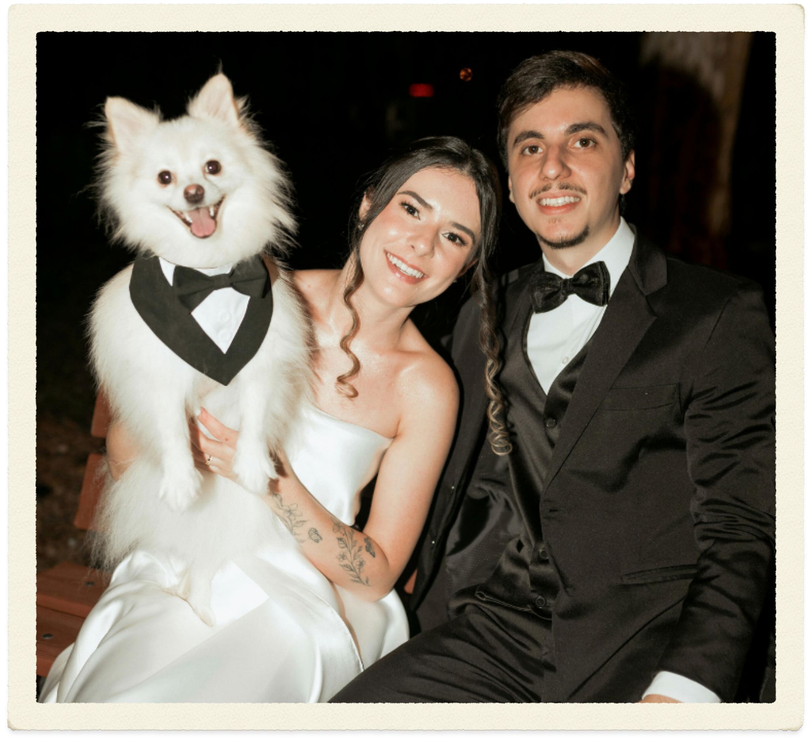
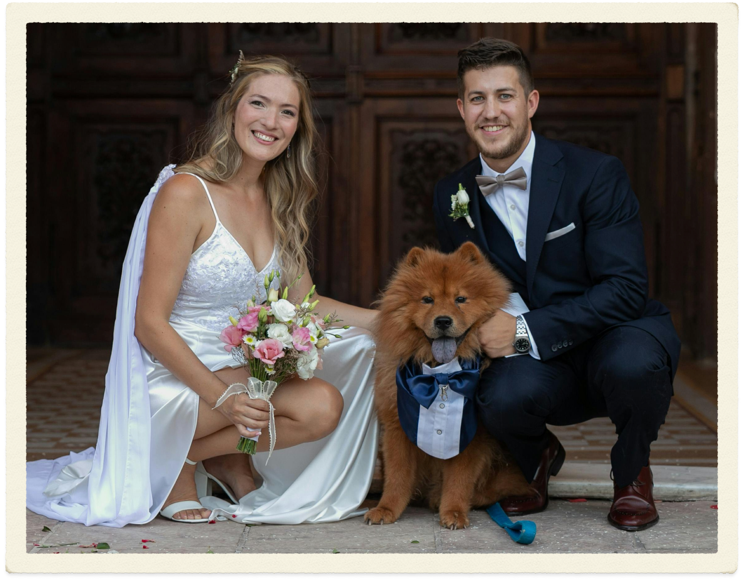



The Doggie Tuxedos
promise
Include the entire family in special occasions.
Eveningwear & training for paws-itively good times.
Create lasting memories you’ll cherish forever.
Notes:
The Doggie Tuxedos promise is that we help our customers → (trigger first element) include the entire family in special occasions by providing quality custom → (fade in tag 2) eveningwear AND training for paws-itively good times, all so you can → (fade in last item) create lasting memories you’ll cherish forever. How do we do that?

Slide 22
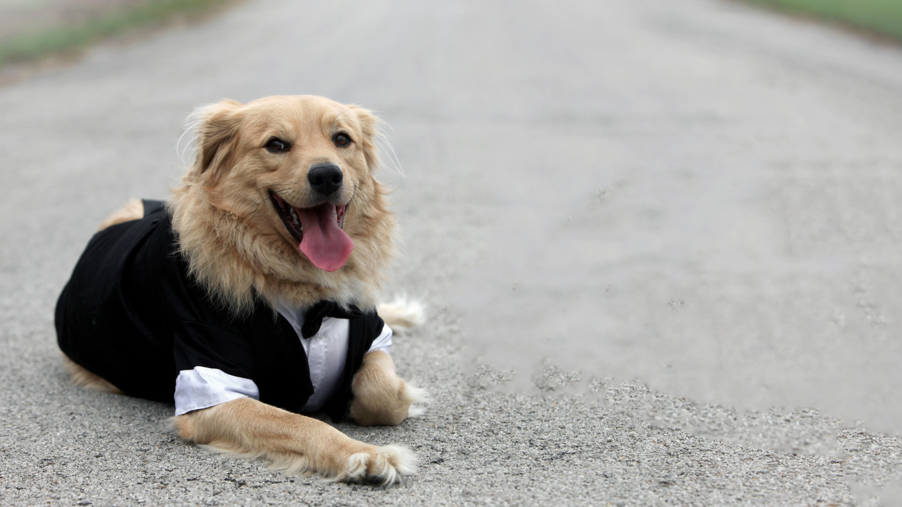





How We Work
Tell us about your dog’s breed & measurements.
Choose from various color & fabric options.
We send your dog the best new duds for your big day!
Each order includes training guides for you & your pup!
Notes:
It’s easy! → Tell us about your dog’s breed & measurements, then → choose from our wide selection of color & fabric options. Maybe you want a classic dapper wool suit, or maybe you’re looking for a bright summery linen or blue seersucker. Whatever you choose, → we send your dog the best new duds for your big day, guaranteed to look like a million bucks, NOT an off the rack costume. Best of all → each order includes easy to follow training guides for you AND your pup, enjoying everyone enjoys furry family memories.

Slide 23
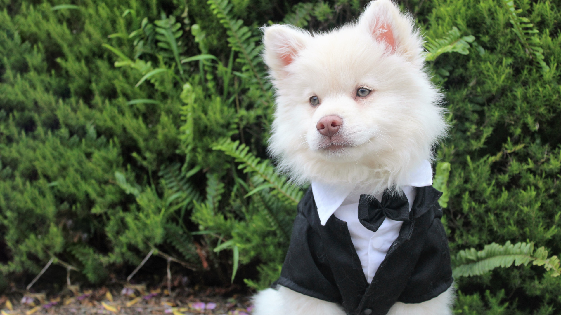


Pricing
Luxury Lapdog
FULL SUIT IN LUXURY FABRICS
$55 Small & Med
$60 Large & XL
+$20 Satin Trim
Fashion Furbaby
JACKET & TIE IN CLASSIC FABRICS
$25 Small & Med
$30 Large & XL
+$15 Twill Upgrade
Notes:
Our prices vary slightly, depending on if you want a simple jacket & tie, all the way up to our Luxury Lapdog line of full suits in luxury fabrics. But they average between $25 all the way up to $80 per item, as you can see here.

Slide 24



Our Scalable Technology
Algorithmic Pattern Scaling
Laser-Guided Manufacture
Our proprietary pattern engine can instantly adjust to fit any dog.
Using cutting-edge CnC tech, we can pattern, cut & produce at scale.
Proven Training Philosophy
Our easy training methods make dressing up & creating memories fun!
Protectable IP. Scalable Manufacture. Ready for Growth.
Notes:
All of this is fueled by our Scalable Technology. We’ve pioneered → Algorithmic Pattern Scaling thanks to our proprietary pattern engine, which can instantly adjust to fit any dog breed. Whether it’s a tiny chihuahua, a narrow but deep chested Samoyed, or a gigantic stout Saint Bernard, we’ve got you covered and tailored to a T. Our → Laser-Guided Manufacturing uses cutting-edge CnC technology, allowing us to pattern, cut, and produce at scale, all while minimizing waste materials. And of course, all of this is built atop → our Proven Training Philosophy developed by top animal behaviorists and veterinary specialists. Our easy training methods make dressing up & creating memories fun for the whole family, not just creating memorable moments, but building happier furry families with better inter-species communication for the long run. Doggie Tuxedos isn’t just a fun brand. It’s → Protectable IP. → Scalable Manufacturing. And we’re → Ready for Growth.
(Note: Again, absolutely none of this is true. But my dog sure can dream!)

Slide 25
Market Opportunity
TAM
$273.4B
SAM
2025 GLOBAL PET MERCHANDISE MARKET
$157B
SOM
US PET MERCHANDISE MARKET
$2.75B
2030 PET CLOTHING MARKET
Notes:
The overall market opportunity is vast! The broader 2025 Global pet merchandising market was valued → at a whopping $273 BILLION dollars, with → The US representing over half at $157 billion. But our specific corner of this market is the → pet clothing market, which is expected to reach $2.75 billion by 2030. This is a rapidly growing market with ample opportunity to be cornered by a scalable, customizable technology brand and we’re just the founders to make it a reality.
(Note: Okay… I actually did research those market valuations, haha.)

Slide 26

Projections
$5.1m
$85.50
AVERAGE ORDER VALUE
$2.7m
$1m
$171k
$42.7k
2024
2025
2026
2027
2028
Notes:
Our average order value is $85.50. In our first year, where we manually tested our basic patterns and began experimenting with laser CnC fabric cutting, we earned $42.7k in sales. When we launched our algorithmic pattern scaling technology on a small scale, our sales jumped to $171k. With our MVP in action now, we’re projecting to reach $1 million in sales this year. As we continue to expand our manufacturing capacity and increase marketing, we expect to see considerable growth.
(Note: You know the drill. My dog’s a big dreamer and an even bigger liar; none of this is true.)

Slide 27









Competitors
Mass Market
Online
Mass Market Retail
Boutiques
Bespoke
Affordable Fashion
High Quality Materials
Wide Variety of Styles
Tailored & Custom Fabrics
Automated to Keep Costs Low
Notes:
The competitive landscape is definitely crowded; there’s no shortage of pet clothing in the $2.4B market. But the key here is the gap. No one has been able to fill this demand for customized, affordable, scalable, high-quality pet garments. You can go to boutiques that charge a premium for high quality garments, or you can head to big chains for cheap costumes. But that leaves a big gap in the middle for us to fill utilizing our proprietary technology.
(Note: This competitor slide isn’t just about repeating features that have already been explained. The goal of a Competitor slide is to explain market dynamics; who are your competitors, what are the market demands at play, and what need(s) aren’t currently being met. It’s about showing where your place in that market is, and why you’re positioned to fill a need no one else can/has/will. It’s about proving why YOU will win!)

Slide 28
Traction
Created the first tuxedo collection.
Dressed our first
shih tzu for Crufts ad.
Q1 2025
Q3 2025
Q2 2024
Q2 2025
Q4 2025
Developed our tuxedo jacket prototype.
Our expert canine tailors developed sizing.
Dressed Harry Styles’ dog, Max.
Notes:
The Doggie Tuxedos story began —> in 2024, when I created our first tuxedo jacket prototype for my own dog, in order to attend my brother’s wedding. We saw such an immense response that we just knew we had stumbled upon something big. —> By Q1 of 2025, we created the first tuxedo collection, which we used as a testing ground as —> our expert canine tailors developed sizing algorithms, ensuring our patterns could fit all the various size and dimension differences between breeds. —> By Q3, we dressed our first shih tzu for a Crufts ad, which was a huge PR and credibility win! It made a big enough splash that in —> Q4, we dressed Harry Styles’ dog, Max, for a photoshoot in London.
(Note: Again, none of this is even remotely true. Harry Styles doesn’t even have a dog. At least as far as I know…)

Slide 29

Roadmap
Launch Canine Cocktail collection with
Add upgrade options: deluxe satin trim.
Reach a very stylish
$2.7 million in sales.
Q4 2026
Q2 2027
Q4 2027
Q1 2027
Q3 2027
Custom fabric printing for photos or designs.
Design line of
‘clutch bag’ harnesses.
Notes:
Looking ahead, —> in the next few months we’ll be launching our deluxe satin trim upgrades, adding additional upsell revenue channels. —> Kicking off 2027 we’ll be launching custom fabric printing for photos or custom designs, through our partnership with Epson, representing immense potential for customers to further customize their formalwear experiences. We’re especially excited to announce that in Q2, we’ll be → launching our Canine Cocktail collection with Chewy, creating our first collab where Chewy customers will be able to customize their Doggie Tuxedos live via Chewy. That is a massive win, gaining access to Chewy’s 21.7 million customers, massively expanding our sales funnel. —> In Q3, we’ll be focused on finalizing our line of ‘clutch bag’ harnesses, allowing dogs to carry key items in style, for duties like being a ring bearer, flower pup, et cetera. All of these key strategic steps will get us to our major milestone of securing —> $2.7 million in sales by the end of 2027, and setting us up for even greater success in 2028.
(Note: Again, none of this is true. We have no partnership or connection with Epson or Chewy, because Doggie Tuxedos does not exist. But can you see how each step shows new strategic steps that justifies how we’ll reach that projected growth? Each step represents something different: increased sales channels, the ability to secure partnerships in multiple aspects of the business, increased manufacturing capacity, new product types, new ways to acquire customers, etc. Showing those strategic steps goes a long way toward showing your ingenuity and ability to set ambitious yet realistically defensible goals. And if you’ve preceded this with a Traction slide built in the same style, showing goals achieved following steps you took to achieve them, we’ll have all the more reason to trust and believe you’ll accomplish your roadmap. But again, this Roadmap slide is a whole heaping helping of hornswagglin’ horse-patties. Aka it’s made up.)

Slide 30
Alternate slide design
with traction & roadmap
in one!
Traction & Roadmap
Custom fabric printing for photos or designs.
Launched & developed algorithmic patterns.
Reach a very stylish
$2.7 million in sales.
Q2 ‘24 - Q2 ‘25
Q1 2027
Q4 2027
Q3 - Q4 2025
Q2 2027
Dressed Crufts ad
& Harry Styles’ dog.
Launch Canine Cocktail collection with
Notes:
Alternate Script for 2 Minute Pitch: We launched —> Doggie Tuxedos in Q2 of 2024, and within a year we had sold over $40k in prototypes and we finalizing our algorithmic pattern scaling technology. —> By Q3 & Q4 of 2025, we dressed a shih tzu for a series of ads for Crufts, and dressed Harry Styles’ dog for a major magazine photoshoot in London, massively increasing our advertising reach and brand awareness. Looking ahead ot next year, we’re thrilled to —> launch our upcoming partnership with Epson, to offer custom fabric printing for photos or designs directly onto fabric. In Q2, we’ll be launching an exclusive —> Canine Cocktail collection with Chewy, massively expanding our top of funnel and securing access to their 21.7 million customers, who will be able to custom order their Doggie Tuxedos formalwear right on Chewy’s website. All of this will fuel our projected —> $2.7 million in sales, supercharging our continued growth.
(Note: Again, none of it’s true. But see how you can easily combine that traction & roadmap for a shorter pitch, hitting the same high points, demonstrating the ability to set and achieve goals, and reasonably justifying projections with the key steps happening beforehand that make that growth possible.)

Slide 31
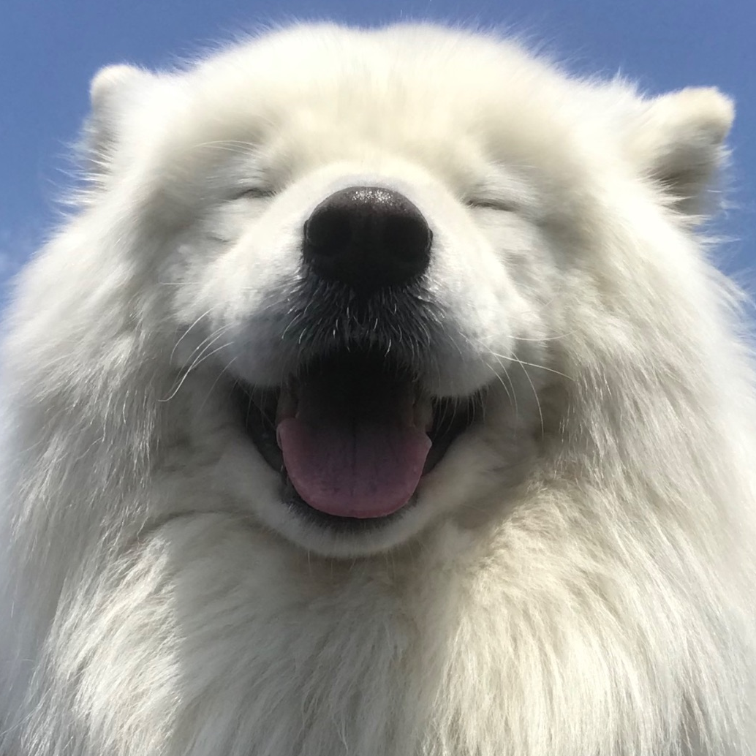
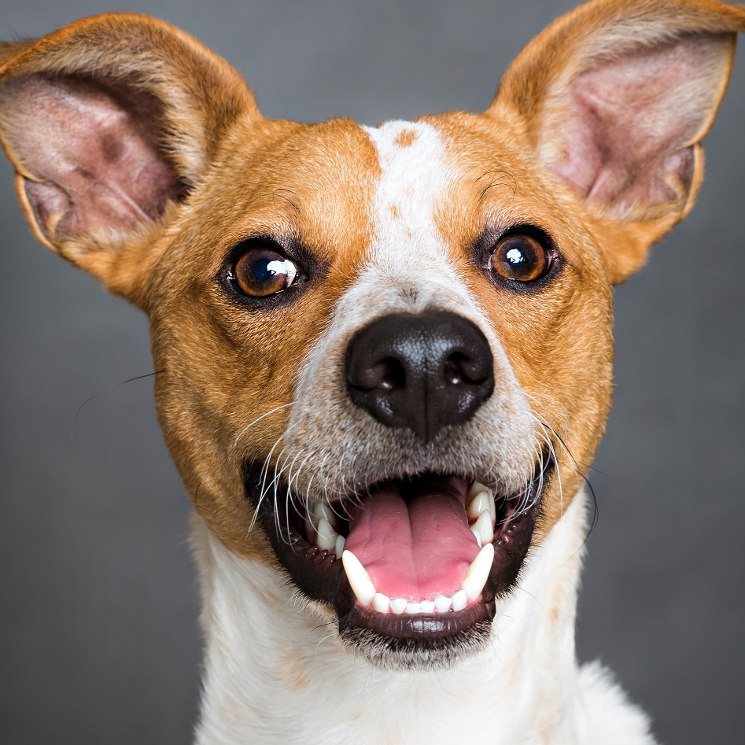
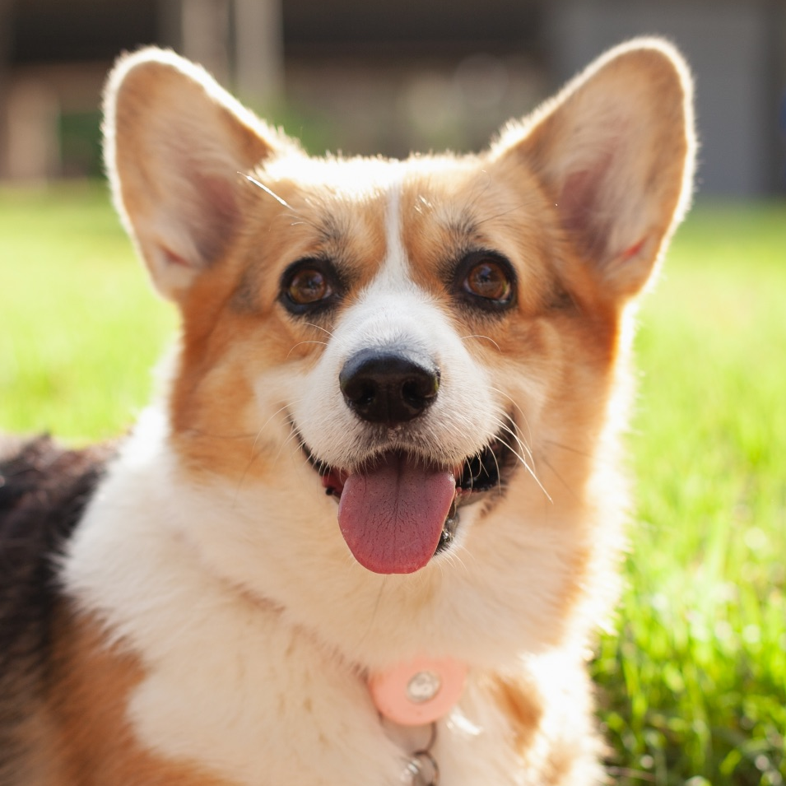
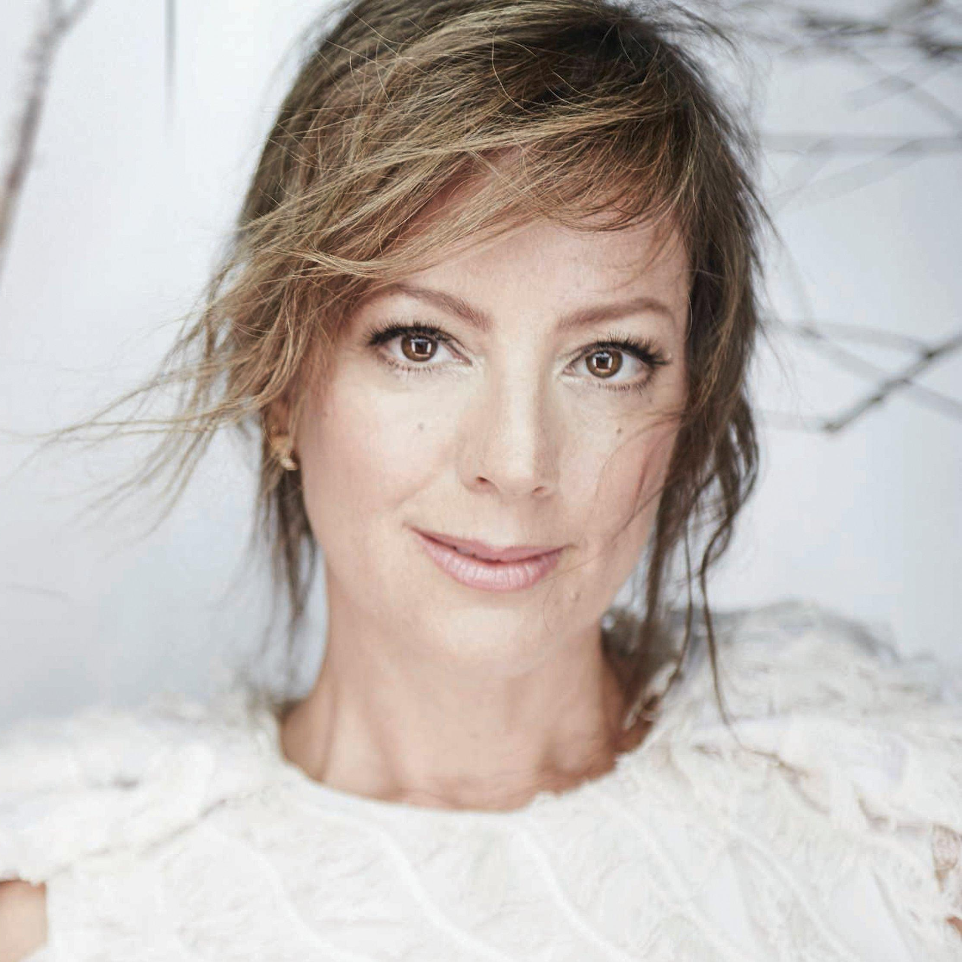







Our Team
Tyberius Lawver
Jack Russell
Mali Pembroke
Sarah McLachlan
FOUNDER & CEO
COO
CTO
CHIEF EVANGELIST
Proud Partners
Notes:
Our team is stacked with industry veterans, technological experts, and a deep network of established trust and credibility. Again, I’m Tyberius, Founder & CEO. I’m a former CFDA recognized fashion designer with experience at multiple leading fashion houses, including Calvin Klein couture and Versace. Our COO is a former executive at Crufts, and our CTO is a proud graduate of MIT who has worked at Google and Meta. We’re especially proud to be joined by our Chief Evangelist, the legendary singer and animal rights activist, Sarah McLachlan. In addition to Chewy and Epson, we’ve also secured partnerships as the official tuxedo provider for The Westminster Kennel Club Dog Show, and a partnership with the American Humane Society, who has certified that our garments pose no health risk to dogs and that our training methods are sound, healthy, and above board. Being able to have their name stand behind us is a huge boost to our credibility and brand recognition.
(Note: You know the drill, say it with me now - none of this is true!)

Slide 32
Our Ask
$1.2m
USE OF FUNDS:
Automate Our Manufacturing
Expand Sales Pipeline
Grow Marketing Team
Fulfill New Contract w/Chewy
Notes:
We’re here today to invite you to join the future of pet formalwear. We’re raising a $1.2 million dollar preseed round in order to further automate our manufacturing, expand our sales pipelines, grow our team, and of course, fulfill our new contract with Chewy to unlock their 21.7 million customers.
(Note: Before we’ve put a price tag on it, the investors already know exactly what we do, how we do it, and where we’re headed. They’re already hooked, all that’s left is to invite them in and show them the price tag. But again, none of this is true.)

Slide 33
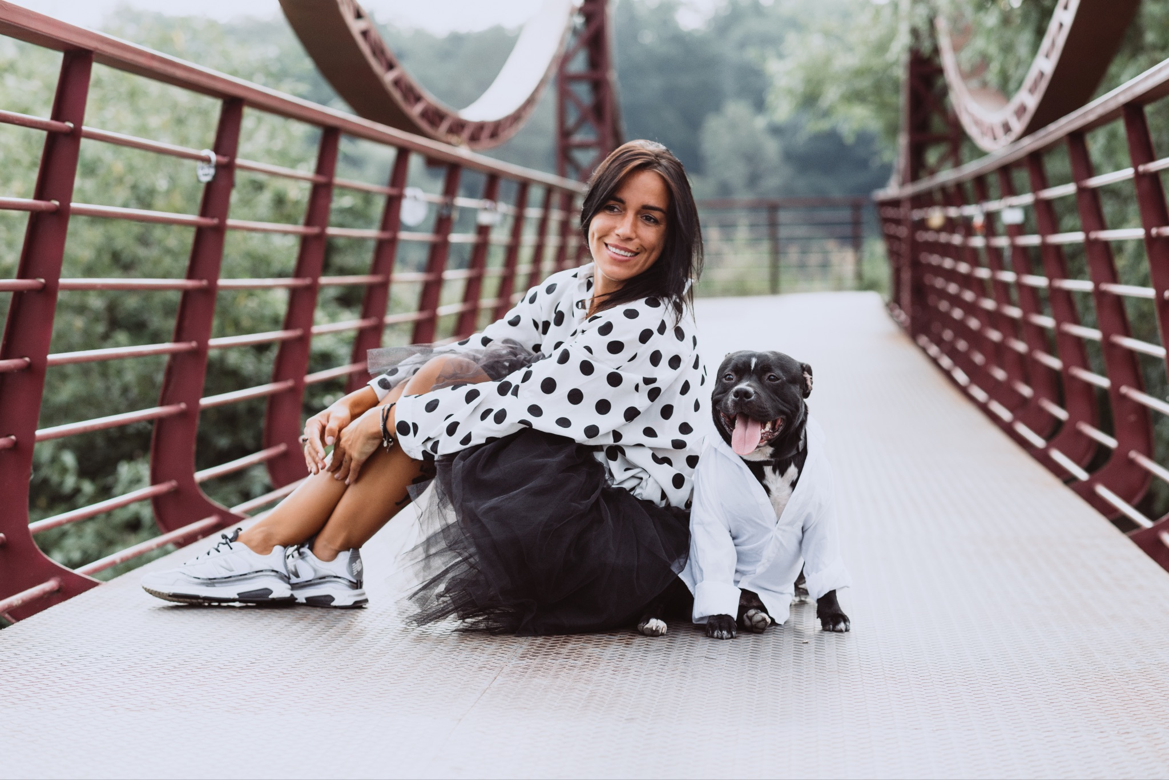

Let’s Make Every Occasion
Pet friendly
& pet fabulous
Notes:
Join us and let’s make every occasion pet friendly & pet fabulous.
(Note: I call this a ‘Grateful Crescendo’ slide, where we remind them of the problem, the mission, and help them feel the excitement of building that world where the problem is solved, because of what we could build together.)

Slide 34
Every Dog Should Feel Like The Best Dog
Thank you!
Tyberius Lawver
FOUNDER & CEO ⬥ TY@DOGGIETUXEDOS.DOG
Notes:
We hope you’ll be part of the Doggie Tuxedos family, where every dog should feel like the best dog. Thank you!
(Note: Always close with a sincere thank you, your logo, name, and contact information. Make it easy as possible for investors to reach out asap! And with that, hopefully you have a better understanding of how to craft a compelling pitch deck! Extra credit if you can then decide which pieces to keep and which to remove to cut this down to only two minutes.)

Slide 35
And a bit of branding
extra credit

Slide 37
YOUR BRAND GUIDES YOUR PITCH
Close your eyes & imagine it’s five years in the future.
What does your dream company look like? When your customer sees your logo on the side of that skyscraper, how do they feel? What do they think about who you are, what you do for them, and why you do it?
Answering these questions is the key to defining your company’s identity & brand.
Brands are effective when they’re strategically meaningful. A brand tells your story, both visually & verbally. It makes your company recognizable & memorable.
Let's build your perfect brand! We'll use the Business Model Canvas to define the
what & why. The Brand Model Canvas will discover the who; your identity & the emotions behind your business. Finally, Pitch Frameworks will create your story.
We’ll use all this info to create your perfect brand, together!

Slide 38
CEEMO • BUSINESS MODEL CANVAS
Refine & define your business plan to discover your value.
Key Partners
Key Activities
Value Propositions
Customer Profiles
Customer Segments
What partners facilitate your business operations?
What activities do you perform to deliver your value proposition?
What pain drives your customer to buy from you? What value do you provide?
Who is your customer? What relationship do they expect you to have & maintain?
Define your exact customer(s); who they are, demographics, where they shop, etc.
Key Resources
Channels
What resources are key to delivering your product & value proposition?
How do you reach your customers? Where do they discover you?
Cost Structure
Revenue Streams
What are the costs of running your business? How do you maintain a healthy profit margin?
How much do your customers pay you? What sales vertical(s) do you rely on?
Based on the Business Model Canvas by Alexander Osterwalder of Strategyzer • Layout design by Heather Lawver
©2020-2025 • Perfectly Pitched Inc • All Rights Reserved • @Ceemoai

Slide 39
CEEMO • BRAND MODEL CANVAS
Refine your value, define your brand. Distill to 3 keywords per segment.
Thoughts & Feelings
Key Activities
Values & Solutions
Relationships
Customer Segments
Imagine it’s 5 years in the future & your ideal customer sees your logo for the first time. What do you want them to think about who you are? How do they feel?
What makes your company unique? What does the world need to know about you?
What do your customers need? What pain point do you solve? How does that tie into your mission? What keywords define the value of your overall identity?
How do your customers relate to you? Who are you to them? How do you build & maintain that relationship? Why does it matter? How does it make them feel?
Define key character archetypes for each customer segment. Who are they? What do they do? Where do they live? What do they care about? Define them as people.
Keys to Growth
Channels
Are resources unique to your brand? What hurdles block your path? Do you need to avoid confusion or negative associations?
How will customers find you? Where do they shop? What apps do they use? What styles grab their attention?
Competitors & Market Placement
Your Future
Who are your main competitors? What do their logos look like? What colors do they use & why? What font styles do they use? How will you both fit into your market & stand out for the right reasons?
Where will your company be in five years? Think about that & review all your other keywords. Distill all your keywords into 3-4 distinct words that encapsulate your branding goals that will get you where you want to go!
Based on the Business Model Canvas by Alexander Osterwalder of Strategyzer • Layout design by Heather Lawver
©2020-2025 • Perfectly Pitched Inc • All Rights Reserved • @Ceemoai

Slide 41
Here’s what Ceemo’s brand looks like all
filled in with meaning!

Slide 42
Thank You & Good Luck Creating Your Perfect Pitch!
GET HELP FOR YOUR PITCH AT MY.CEEMO.APP TODAY
Heather Lawver
FOUNDER & CEO • HEATHER@CEEMO.AI • ©2026 Ceemo.ai

Slide 43
Get Help for Your Pitch at My.Ceemo.App Today!
Heather Lawver
FOUNDER & CEO • HEATHER@CEEMO.AI • ©2026 Ceemo.ai

